Slide 1
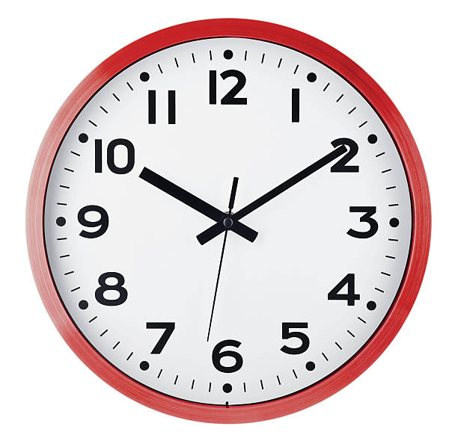
CLOCKS

Slide 2
CONCEPT BASE
DIAL:
The face or dial of a clock is a circle whose circumference is divided into 60 equal parts, called minute spaces.
They are marked by short lines in the face of the clock. However, the end of every fifth minute space is marked longer than the others and the 60 minute spaces are represented as 12 divisions or 12 hour spaces.

Slide 3
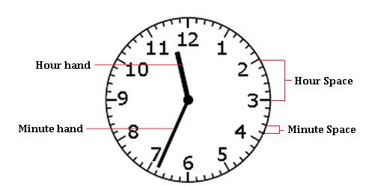
They are usually numbered from 1 to 12 as shown in the figure below.

Slide 4
HANDS OF THE CLOCK:
A clock has two hands; the smaller one is called the hour hand or short hand while the larger one is called the minute hand or long hand as shown in the figure above.
The hands of the clock are the indicators of time.
The time is read based on the positions of the hands with respect to minute or hour spaces.

Slide 5
UNIT OF TIME:
The unit of time in clocks is seconds.
A second, the SI unit of time, is defined as the natural periodicity of the radiation of a caesium-133 atom.
A duration of 60 seconds is defined as a minute.
In clocks, it is also defined as the time taken by the minute hand to move across a minute space.
A duration of 60 minutes is defined as an hour.
In clocks, it is also defined as the time taken by the hour hand or short hand to move across five minute spaces or one hour space.
A day is also defined as the duration of 24 hours

Slide 6
The time is measured owing to the movement of the hands of a clock. A complete rotation of any of the hands would cover a measure of 360 degrees (circular displacement) .
Degree is the unit of measurement of angles and is denoted by the symbol °.
Hour hand covers an angle of 360° in 12 hours. So, the hour hand in one hour will cover 360 /12 = 30°.
So for every minute, the hour hand moves through 30 /60 = 0.5 °.

Slide 7
Minute hand covers an angle of 360° in 1 hour. So for every minute, the minute hand moves through 360/60 = 6 °.
Both the hands of the clock move in same direction.
So, their relative displacement for every minute is 5.5° or 11/2°.
This 5.5° movement constitutes the movements of both the hands.
So for every minute, both the hands give a relative displacement of 5.5°.

Slide 8
FORMULA TO FIND THE ANGLE BETWEEN THE HANDS OF THE CLOCK:
𝜃=30°𝐻− 11/2𝑀
(when the minute hand is trailing the hour hand) 𝜃=11/2𝑀− 30°𝐻
(when the minute hand is leading the hour hand)
𝜃 = Angle between the hands of the clock
30°𝐻 = Initial gap; H - the division pointed by the hour hand which indicates the gap between the minute hand and hour hand initially when multiplied by 30°.
11/2𝑀 = Relative displacement for a period of time; 11/2 - Relative speed of the hands of the clock; M - no. of minute spaces moved by the minute hand.

Slide 9
COINCIDENCE OF THE HANDS OF THE CLOCK:
At 12 o' clock, the hands of the clock overlap i.e. the angle formed between them is 0°.
To find the next time they overlap, the gap between them should be 360° so that they are at the same point. Hence it takes,
11/2 × t = 360
t = 720/11 = 65 5/11 minutes
Thus, it can be easily concluded that the hands of the clock coincide every 65 5/11 minutes.

Slide 10
FREQUENCY OF FORMATION OF ANGLES BETWEEN THE HANDS OF THE CLOCK:
With the relative displacement, it is easier to find the frequency at which the hands of a clock form a particular angle.
Let's find the no. of times the hands of the clock form 0° in a day.
We know that the hands of the clock coincide every 65 5/11 or 720/11 minutes. So, in a day there are 24 × 60 = 1440 minutes
Therefore, in a day the hands of the clock coincide (1440 × 11) / 720 = 22 times.

Slide 11
Thus, it can be inferred that the hands of the clock coincide once in every hour except for two occasions i.e. from 11 to 1 o' clock they coincide only once at 12 o' clock.
So, it is 11 times in 12 hours and thus 22 times in 24 hours.
The finding can be extended to other angles by applying the formula,
𝜃= 30°𝐻− 11/2𝑀 or
𝜃= 11/2𝑀− 30°𝐻
for every hour in the clock.

Slide 12
GAIN AND LOSS OF TIME IN AN INCORRECT CLOCK:
A normal clock becomes incorrect when there is a change in the speeds of the hands of the clock.
As seen already, duration of a day is measured by the time taken by the hour hand to move across the 12 divisions twice.
So, when the speed of the hands of the clock increases they complete their rotation for a day sooner.
Thus, they result in loss of time when actually compared with the duration for a day in a correct clock .
Similarly, when the hands of the clock move slower than usual, they take more time to complete the rotations for a day.
Thus, they result in gaining more time for a day when compared with that in a correct clock.

Slide 14
KEY POINTS:
1. In 60 minutes, the minute hand gains 55 minutes on the hour hand
2. The hands of the clock coincide every 65 5/11 minutes and for every hour, both the hands coincide once
3. The hands are in the same straight line when they are coincident or opposite to each other
4. When the two hands are at right angles, they are 15 minute spaces apart

Slide 15
5. When the hands are in opposite directions, they are 30 minute spaces apart
6. The hands of the clock form an angle of 0° or 180° − 22 times a day
7. The hands of the clock form an angle of 1° to 179° − 44 times a day
8. If a watch or a clock indicates 8:15, when the correct time is 8, it is said to be 15 minutes faster than the correct time. On the other hand, if it indicates 7:45, when the correct time is 8, it is said to be 15 minutes slow.

Slide 16
PRACTICE QUESTIONS

Slide 17
1. Find the angle between the hands of a clock when the time is 5:40.
80⁰
160⁰
70⁰
120⁰

Slide 18
2. Find the angle between the minute hand and the hour hand of a clock when the time is 7:20. (a) 80⁰
(b) 90⁰
(c) 100⁰
(d) 110⁰

Slide 19
3. The reflex angle between the hands of a clock at 10:25 is
180⁰
162.5⁰
(c) 165⁰
(d) 197.5⁰

Slide 20
4. Find the angle between the hour hand and the minute hand of a clock when the time is 15:25.
47.5 ⁰
45.5 ⁰
50 ⁰
None of these

Slide 21
5. At what time between 5 p.m. and 6 p.m., do the hands of a clock coincide?
(a) 8 hour 29 3/11 min
(b) 9 hour 33 8/11 min
(c) 5 hour 27 3/11 min
(d) None of these

Slide 22
6. Find at what time (in minutes) past 8 o' clock but before 9 o' clock will the hands of a clock be in the same straight line but not together.
100/11
(b) 110/11
(c) 120/11
(d) None of these

Slide 23
7. How many times in a day do the hands of a clock form 90⁰?
22
(b) 33
(c) 44
(d) 55

Slide 24
8. A few times per day, the minute hand of a clock is exactly above (or below) the hour hand. How many times per day does this occur?
11 times
(b) 24 times
(c) 22 times
(d) 44 times

Slide 25
9. At how many times between 12 o'clock and 1 o' clock are the minute hand and the hour hand of a clock at an angle of 90 degrees to each other?
4
(b) 6
(c) 3
(d) 2

Slide 26
11. My watch was 8 minutes behind at 8 p.m. on Sunday but it was 7 minutes ahead of time at 8 p.m. on Wednesday. During this period, at which time has this watch shown the correct time?
Tuesday 10.24 a.m.
(b) Wednesday 9.16 p.m.
(c) Tuesday 11.24 p.m.
(d) Wednesday 9.16 a.m.

Slide 27
12. The minute hand of a clock overtakes the hour hand at intervals of 65 minutes of the correct time. How much a day does the clock gain or lose in minutes?
1440/143
(b) 1444/143
(c) 1400/143
(d) 4440/143

Slide 28
13. A clock is set right at 8 a.m. The clock gains 10 minutes in 24 hours. What will be the true time when the clock indicates 1 p.m. on the following day?
48 min past 12
(b) 48 min past 11
(c) 45 min past 12
(d) 45 min past 11

Slide 29
14. At what time between 4 and 5 o'clock, will the hands of a watch point in opposite directions?
(a) 54 min past 4
(b) 53 7/11 min past 4
(c) 54 7/11 min past 4
(d) 54 6/11 min past 4

Slide 30
16. At what time between 5.30 and 6 o' clock, will the hands of a clock be at right angles?
43 5/11 min past 5
(b) 43 7/11 min past 5
(c) 5 p.m.
(d) 7 p.m.

Slide 31
17. Find the reflex angle between the hour hand and the minute hand of a clock when the time is 11:25.
192.5 ⁰
(b) 230 ⁰
(c) 45 ⁰
(d) 72 ⁰

Slide 32



